Slide 1

Computer Communications
& Networks
CSNC-2413
Computer Networking:
A Top Down Approach
6th edition
Jim Kurose, Keith Ross
Addison-Wesley
March 2012
Ch 3 : Reliable Data Transfer
Dr David Samuel
Faculty of Information Technology (FIT)
University of Central Punjab (UCP)

Slide 2
Chapter 3 outline
3.1 Transport-layer services
3.2 Multiplexing and
demultiplexing
3.3 Connectionless
transport: UDP
3.4 Principles of reliable data
transfer
3.5 Connection-oriented
transport: TCP
  segment structure
  reliable data transfer
  flow control
  connection management
3.6 Principles of congestion
control
3.7 TCP congestion control

Slide 3
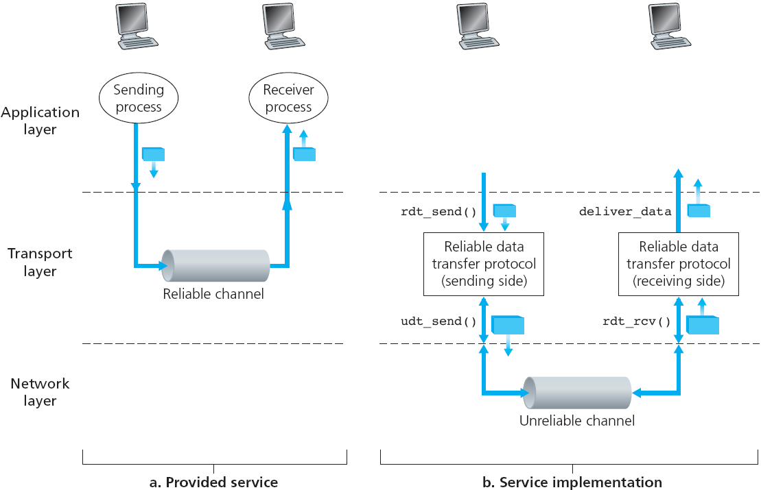
Principles of Reliable data transfer
Reliable data transfer service by Transport layer, over unreliable Network layer

Slide 4
Channel with NO bit errors/loss etc
If underlying channel is perfectly reliable…
  no bit errors
  no loss of packets
  no out of order delivery
Sender & receiver just send/receive data…
  sender sends data into underlying channel
  receiver reads data from underlying channel

Slide 5
Channel with bit errors
underlying channel may flip bits in pkts
  use checksum to detect bit errors - recall UDP checksum
  if in error, drop pkt
now how to recover from errors..? need feedback..!
  Acknowledgement (ACK):
    receiver tells sender – pkt received OK – transmit next
  Negative Acknowledgement (NAK):
    receiver tells sender – pkt had errors – retransmit
new mechanisms…
  error detection thru checksum
  receiver feedback thru control msgs (ACK, NAK) from rcvr -> sender

Slide 6
A fatal flaw
What happens if ACK/NAK corrupted?
sender doesn’t know if pkt recvd correctly or incorrectly at
receiver…
can’t transmit new pkt
can’t re-transmit old pkt
stuck..!
Just retransmit old pkt…
might cause re-transmission of correctly received pkt..!
how to handle Duplicates..!
Handling duplicates:
sender adds Sequence Number to each pkt
if ACK/NAK garbled, sender re-transmits current pkt
receiver discards duplicate pkt due to Seq Num
(doesn’t deliver up)
Stop and Wait protocol
Sender sends one packet,
then waits for receiver
response

Slide 7
Sender receiver actions
Sender:
adds seq# to pkt
two seq# (0,1) will suffice... Why?
must “remember” whether “current” pkt has
seq# 0 or 1
Receiver:
must check if received pkt is duplicate
  must know whether
  expected pkt seq# is 0 or 1
  duplicate not delivered up
Note: receiver can not know if its last ACK/NAK was received OK at sender

Slide 8
NAK-free protocol
Same functionality as earlier, but using ACKs only
Instead of NAK,
  receiver sends…
“ACK for last pkt received OK”
  receiver must explicitly include…
  “seq# of pkt being ACKed”
Duplicate ACK at sender results in same action as NAK; retransmit current pkt
TCP uses NAK-free approach

Slide 9
Channel with bit errors & pkt loss
New assumption:
underlying channel can also
“lose“ packets (Data or ACKs)
  checksum, ACKs, Seq#, retransmissions will be of help,
  but not enough
Q: how to deal with loss?
  sender waits if certain data
  or ACK lost, then re-transmits
Use Countdown timer…
sender waits “reasonable” amount of time for ACK
if no ACK received in this time, retransmit
if pkt (or ACK) just delayed (not lost)…
  re-transmission will be duplicate
  but use of Seq# already
  handles this
What is the “right value” for timer…? depends on network conditions…!

Slide 10
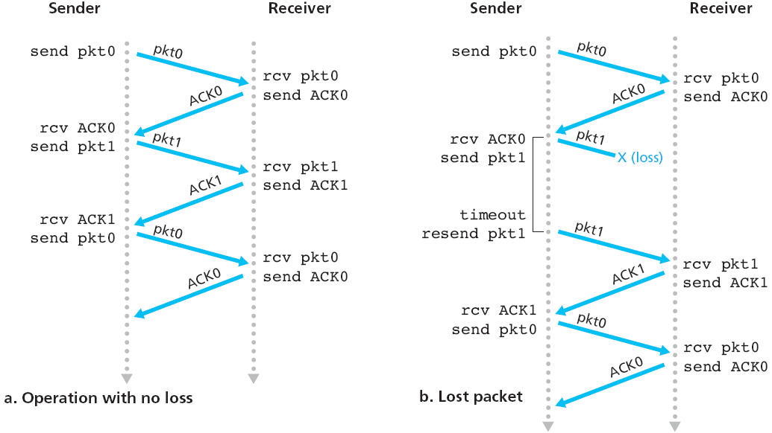
Protocol in action

Slide 11
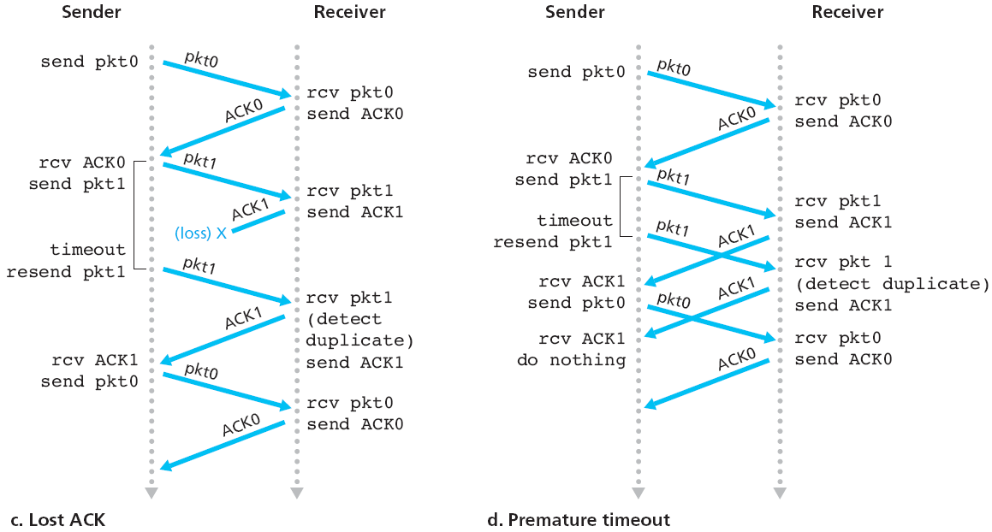
Protocol in action

Slide 12
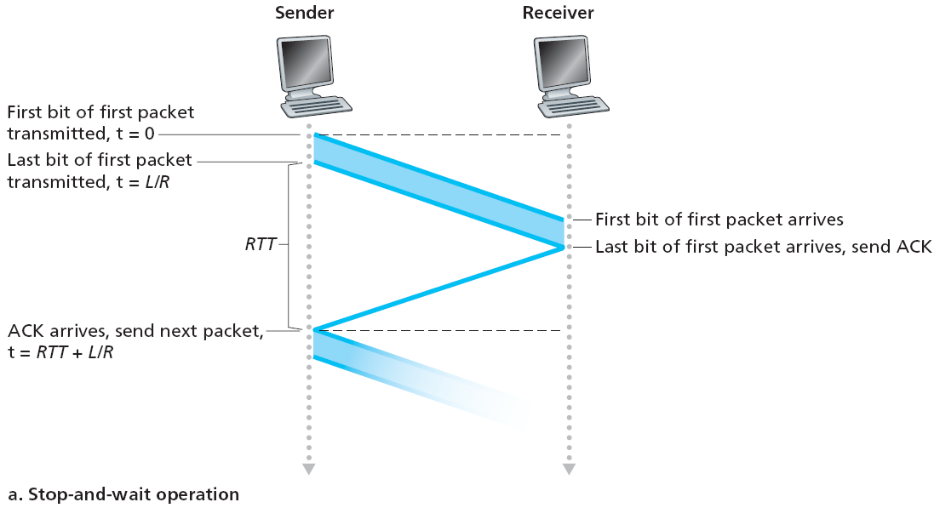
Stop-and-wait operation

Slide 13

Stop-and-wait performance
Protocol is correct, but performance poor…
e.g, 1 Gbps link, 15 ms prop delay, 8000 bits pkt
L
8000 bits
D_{trans} =
=
=
8 microsec
R
10⁹ bits/sec
  U _{sender}: utilization – fraction of time sender busy sending data
  if RTT = 30 msec, 1KB pkt every 30 msec
  Thruput = data/time = 267 kbps ….(too less)
network protocol may limit use of physical resources..!

Slide 14


Pipelined protocols
Pipelining: sender allows multiple, “in-flight”, yet-to-be-Acknowledged pkts
  increases transmission efficiency
  range of sequence numbers must be increased
  buffering at sender and/or receiver

Slide 15
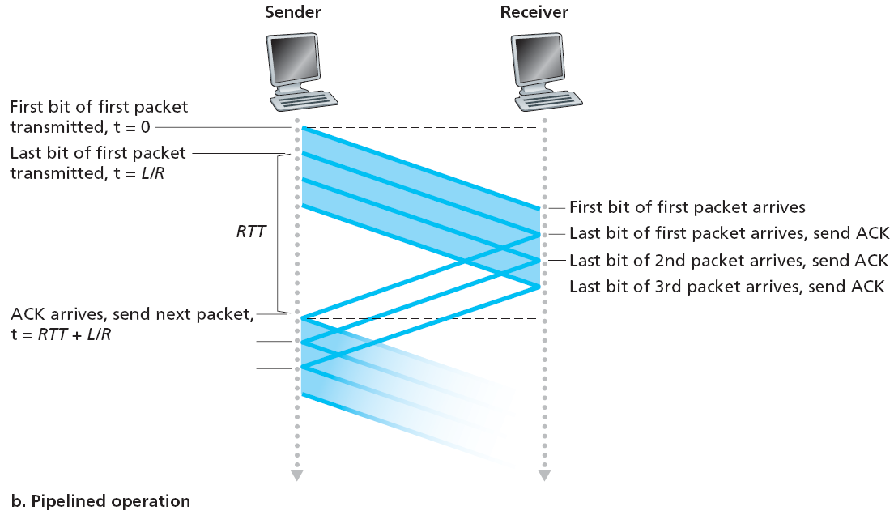

Pipelining: increased utilization

Slide 16
Pipelined protocols
Sender & Receiver agree upon a Widow size
  sender sends upto N pkts at a time, without receiving an ACK
  “up to N unACKed packets in pipeline”
Two generic forms of pipelined protocols:
Go-Back-N and Selective Repeat
Go-back-N:
when pkt is lost,
sender retransmits all the pkts, starting from the one lost
Selective Repeat:
when pkt is lost,
sender retransmits only the lost pkt

Slide 17

Go-Back-N Protocol
sender window (N=4)
sender
receiver
0 1 2 3 4 5 6 7 8
send pkt0
send pkt1
send pkt2
send pkt3
(wait)
0 1 2 3 4 5 6 7 8
receive pkt0, send ack0
receive pkt1, send ack1
receive pkt3, discard,
(re)send ack1
0 1 2 3 4 5 6 7 8
X
0 1 2 3 4 5 6 7 8
loss
0 1 2 3 4 5 6 7 8
rcv ack0, send pkt4
rcv ack1, send pkt5
0 1 2 3 4 5 6 7 8
receive pkt4, discard,
(re)send ack1
ignore duplicate ACK
receive pkt5, discard,
(re)send ack1
pkt 2 timeout
0 1 2 3 4 5 6 7 8
send pkt2
send pkt3
send pkt4
send pkt5
0 1 2 3 4 5 6 7 8
0 1 2 3 4 5 6 7 8
rcv pkt2, deliver, send ack2
rcv pkt3, deliver, send ack3
rcv pkt4, deliver, send ack4
rcv pkt5, deliver, send ack5
0 1 2 3 4 5 6 7 8

Slide 18

Go-Back-N: sender
Sender assumes “window” size of N packets…
(upto N consecutive unACK’ed pkts can be sent)
ACK(n): ACKs all pkts up to & including Seq# n - “cumulative ACK”
  may receive duplicate ACKs
Timer: for oldest in-flight pkt
timeout(n): retransmit pkt n and all higher Seq# pkts in window

Slide 19
GBN: receiver
ACK-only:
  always send ACK for correctly-received pkt,
  with highest, in-order Seq#
  may generate duplicate ACKs
Out-of-order pkt:
  discard (don’t buffer): no receiver buffering!
  re-ACK pkt with highest, in-order Seq#

Slide 20

Selective repeat in action (N=4)
Under GBN, this pkt will be dropped

Slide 21
Selective Repeat (improvement of the GBN Protocol)
Receiver individually ACKs all correctly received pkts
Buffers pkts, as needed, for in-order delivery to upper layer
  e.g, Sender sends pkt 1, 2, 3, 4,…., 10
  Receiver got 2, 4, 6, 8, 10
  Sender resends 1, 3, 5, 7, 9 only
Sender only resends pkts for which ACK not received
  sender timer for EACH unACKed pkt
Sender window
  N consecutive Seq#
  again limits Seq# of sent, unACKed pkts

Slide 22

Selective repeat: sender, receiver windows

Slide 23

Selective repeat: dilemma
In real life, we use k bits to implement Seq#
A practical issue…!
Example:
Seq#: 0, 1, 2, 3
if window size (N)=3
issue: receiver sees no difference in two scenarios!
wrongly receives duplicate data as new (in lower fig)
Q: what relationship between Seq# size and window size?
N ≤ 2^{k}/2

Slide 24
Pipelined protocols: overview
Go-back-N:
sender can have up to N unACKed packets in pipeline
receiver sends
cumulative acks
sender has timer for oldest unACKed packet
  when timer expires, retransmit all packets in the window, starting from unACKed packet
Selective Repeat:
sender can have up to N unACKed packets in pipeline
rcvr sends individual ACK for
each packet
sender has timer for each
unACKed packet
  when timer expires,
  retransmit only the
  unACKed packet

